Slide 1
Ian J. Goodfellow
->google brain
->made GAN
->author of Deep Learning

Slide 2
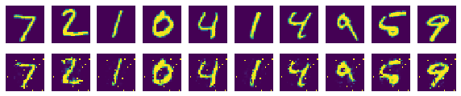
. Deep generative models
Autoencoder
Generative Adversarial Networks
Not same!
https://github.com/gudrb/GAN/blob/master/autoencoder.ipynb

Slide 3
Deep generative models have had less of an impact
Difficulty of Maximum likelihood estimation
Difficulty of leveraging the benefits of piecewise linear units in the generative context
Succession of Deep generative models
Generative Adversarial Networks
Backpropagation
Drop out algorithm

Slide 4
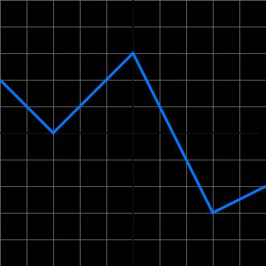
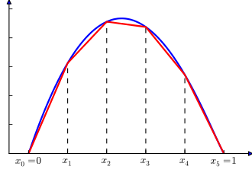
Piecewised-linear

Slide 5
adversarial process
대립하는, 적대하는
-> generator, discriminator (two models(G,D))
G:capture data distribution
D:estimates the probability of real sample
=>minimax two-player game

Slide 6
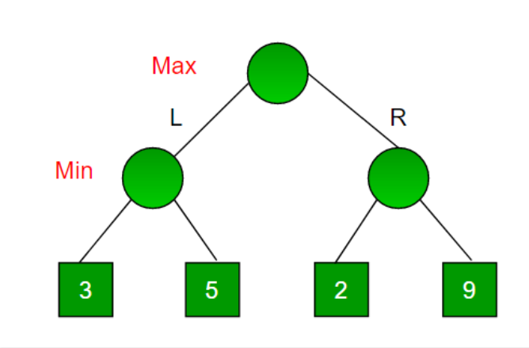
minimax two-player game
Max – right
Min – left
3
Max – left
Min – right
2
Choice: 3
Backtracking
Maximizer, Minimizer
Maximizer: effort to get high score
Minimizer: effort to get low score
Unique
answer
(G,D)
G: make same data with training data
D: estimate probability =1/2

Slide 7
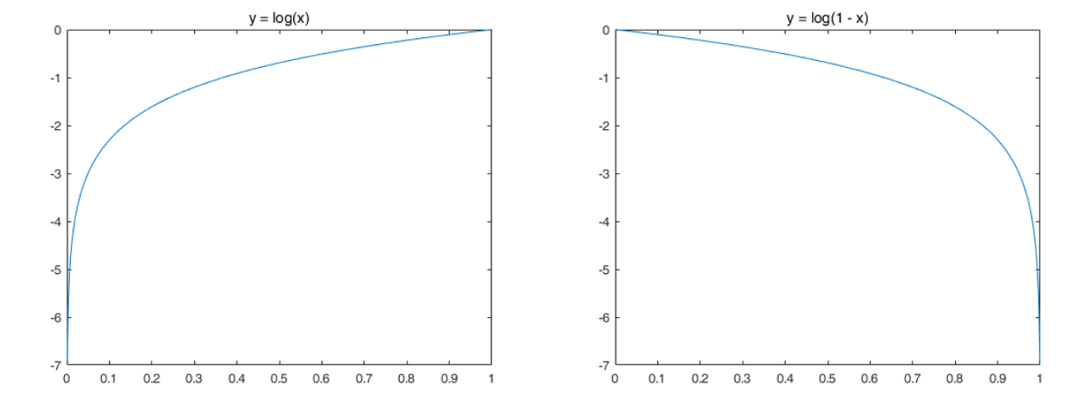
D and G play the following two-player minimax game with value function V (G, D):
x: data variable , z: noise variable, G(z): fake data
D:
D(x)=1
D(G(x))=0
G:
D(x)=0
D(G(x))=1
D(x)=1/2
D(G(x))=1/2

Slide 8
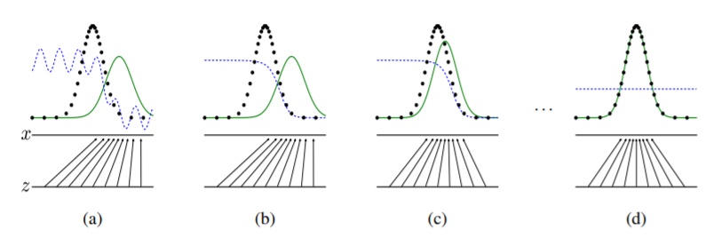



Optimizing D inner loop is prohibitive
$${sample from p}_{x}$$
D(x)
$$p_{g}$$
G(z)
k steps of optimizing D and one step of optimizing G
D: near optimal solution
G: change slowly enough
If not,
D: overfitting
G: change fastly
(yellow arrow)

Slide 9
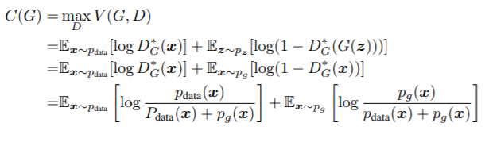
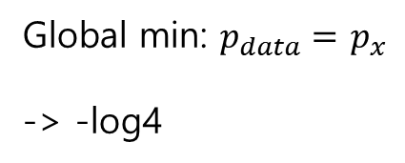
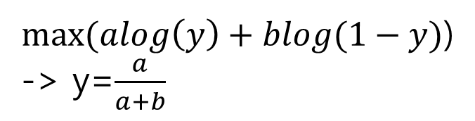
Proof of optimal D
$max⁡(alog\left(y\right)+blog(1−y)$)
-> y=$\frac{a}{a+b}$
Global min: $p_{data}=$ $p_{x}$
-> -log4

Slide 10
For G to learn more well
G : log(1-D(G(z)) Minimize
G : log(D(G(z)): Maximize

Slide 11
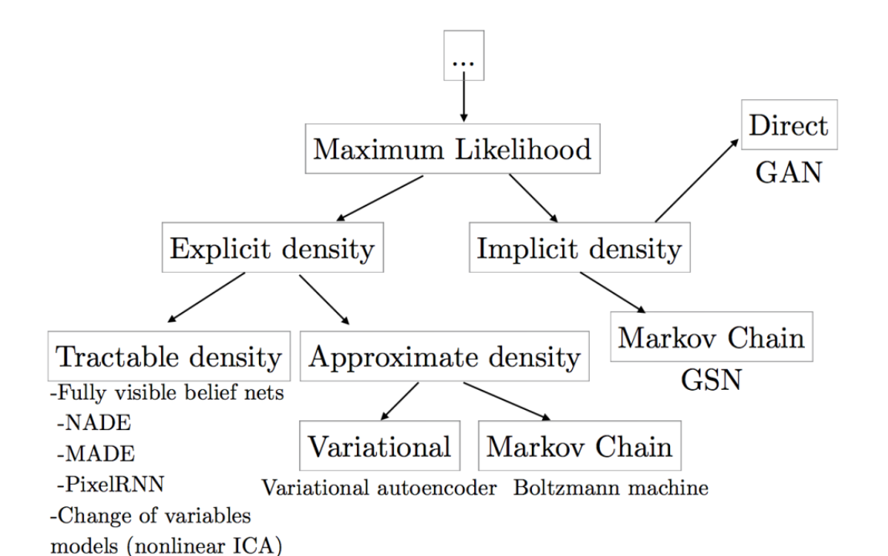
Explicit, Implicit

Slide 12
Markov chains
Markov chains or unrolled approximate inference networks during either training or generation of samples ??
s. Experiments demonstrate the potential of the framework through qualitative and quantitative evaluation of the generated samples. ??
and sample from the generative model using only forward propagation

Slide 13
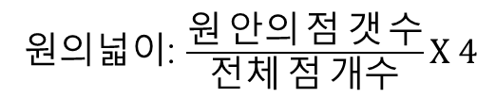
MCMC(Markov Chain Monte Carlo)
어떤 목표 확률분포(Target Probability Distribution)로부터 샘플링을 통해 랜덤 샘플을 얻는 방법이다
Monte Carlo
Markov Chain <-> stochastic sampling(mini batch)
원의넓이: $\frac{원 안의 점 갯 수}{전체 점 개수}X 4$
몇 가지 추가 조건이 만족한다면, k가 충분히 커지면 Xk의 분포는 특정한 값으로 수렴한다
즉, stationary distribution 된다.
목표분포를 stationary distribution으로 만들고 샘플링 한다.
샘플은 stationary distribution을 따른다
-> gradient 측정가능

Slide 14
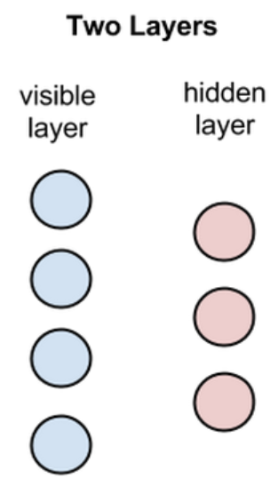
Restricted Boltzmann Machines
-> Markov chain
While RBMs are occasionally used, most practitioners in the machine-learning community have deprecated them in favor of generative adversarial networks or variational autoencoders.
Restricted: no intra-layer communication
Undirected layer

Slide 15
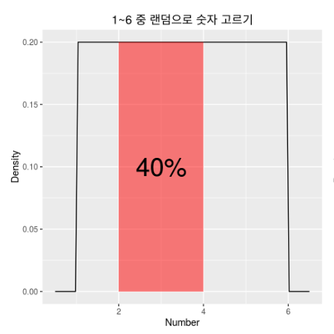
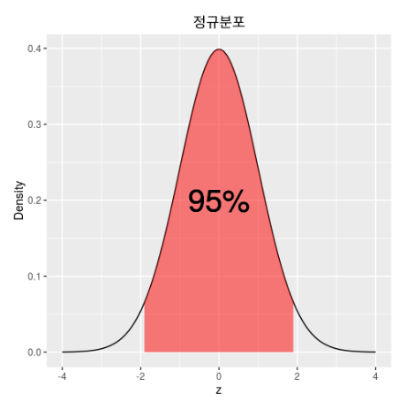
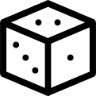
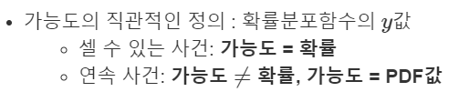
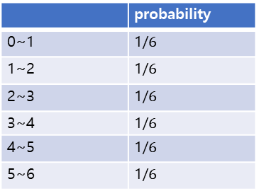
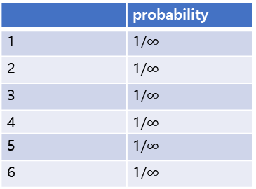
Probability Density Function, PDF
 | probability
1 | 1/6
2 | 1/6
3 | 1/6
4 | 1/6
5 | 1/6
6 | 1/6
 | probability
1 | 1/$∞$
2 | 1/$∞$
3 | 1/$∞$
4 | 1/$∞$
5 | 1/$∞$
6 | 1/$∞$
정규분포
 | probability | likelyhood
0(MLE) | 0 | 0.4
999 | 0 | 0
0~6
 | probability
0~1 | 1/$6$
1~2 | 1/$6$
2~3 | 1/$6$
3~4 | 1/$6$
4~5 | 1/$6$
5~6 | 1/$6$

Slide 16

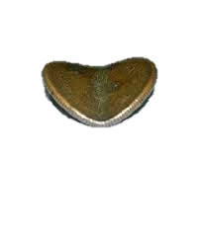
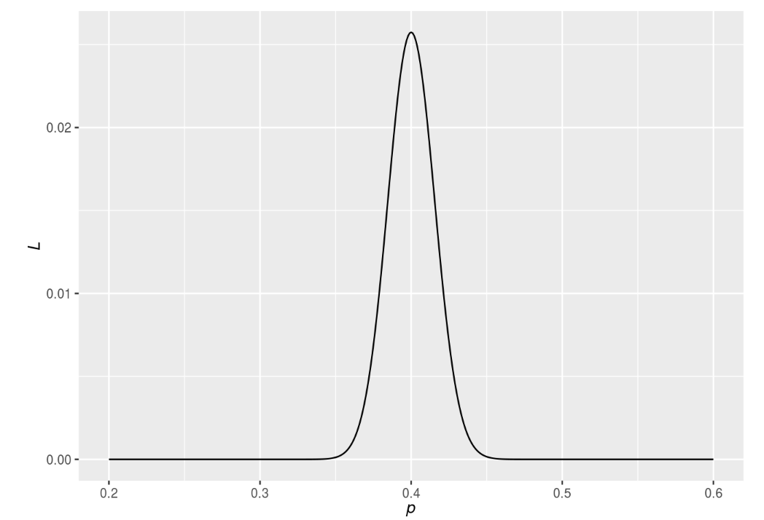
Maximum likelihood estimation
최대우도법(最大尤度法)은 어떤 확률변수에서 표집한 값들을 토대로 그 확률변수의 모수를 구하는 방법이다. 어떤 모수가 주어졌을 때, 원하는 값들이 나올 가능도를 최대로 만드는 모수를 선택하는 방법이다.
모수: 동전 앞면 나올 확률(p)
표집 값: 1000번 던짐
가능도: 모수에 따른 앞면이 나올 확률
미분후
L’ =0
인 p 값 구하면됨
앞: 400
뒷: 600
L
p
확률 밀도함수

